Slide 1




ScentSoul

Slide 2


Car Mate
AI 驱动二手车车价 查询预测系统
机器学习 | 时间序列 | 人工智能

Slide 3
Car Mate
AI 驱动二手车车价 查询预测系统
机器学习 | 时间序列 | 人工智能

Slide 4


Scent Soul
Your personal fragrance finder
Here are three ways to find your perfect match

Slide 6




$
$
$

Slide 7

$

Slide 8








Slide 9

ScentSoul
Scent Soul
Your personal fragrance finder
Here are three ways to find your perfect match
- Since 2018
TAKE A QUIZ
FIND SIMILAR
SIGN IN

Slide 10


Tell me something about you…

Slide 11

CarMate
Scent Soul
CarMate
CarMate
CarMate

Slide 12






Slide 14


Slide 15


Slide 17
ScentSoul
Sign in About ScentSoul Contact me
ScentSoul
Your personal fragrance finder
Here are three ways to find your perfect match
TAKE A QUIZ
FIND SIMILAR
SIGN IN

Slide 18
https://www.thebathhouseshop.co.uk/woods-fragrance/
ScentSoul
Sig n in About ScentSoul Contact me
ScentSoul
您的香水管家
有三种方法带您寻找您的最爱
TAKE A QUIZ
FIND SIMILAR
SIGN IN

Slide 19
Scent Soul
Your personal fragrance finder
Here are three ways to find your perfect match

Slide 20

LOVE FROM ABOVE
Speaking from the heart with divine eloquence
such lovely fragrance love's inheritance

Slide 21
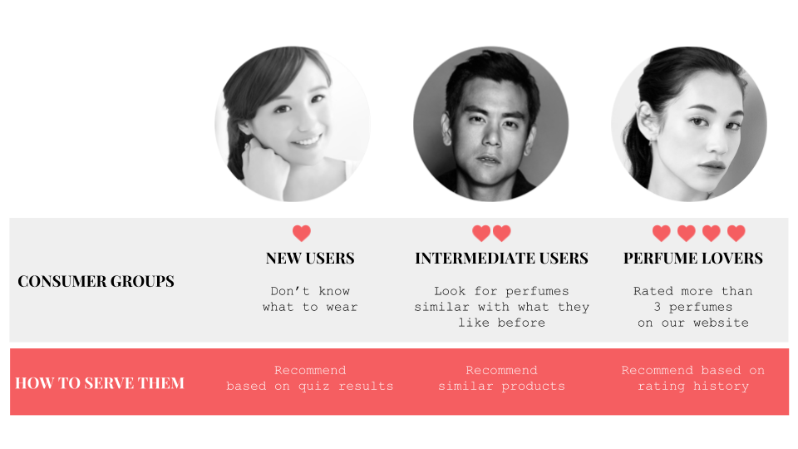

Slide 22


ScentSoul

Slide 23
ScentSoul
ScentSoul

Slide 24


Slide 25


Slide 26
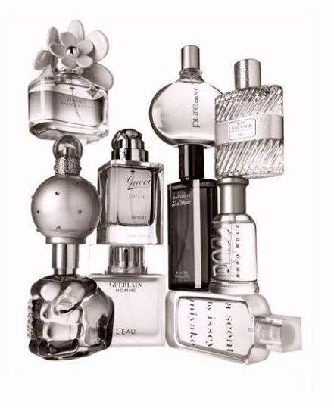



Slide 27

Scent Soul

Slide 29


Slide 30
https://www.thebathhouseshop.co.uk/citrus-fragrance/

Slide 32


Slide 33
ScentSoul
Sing in About ScentSoul Contact me
ScentSoul
Your Personal fragrance finder
Ready to find the next fragrance?
Here are three ways to find your perfect match

Slide 34
ScentSoul
Sing in About ScentSoul Contact me
ScentSoul
Your Personal fragrance finder
Ready to find the next fragrance?
Here are three ways to find your perfect match

Slide 38


Slide 40
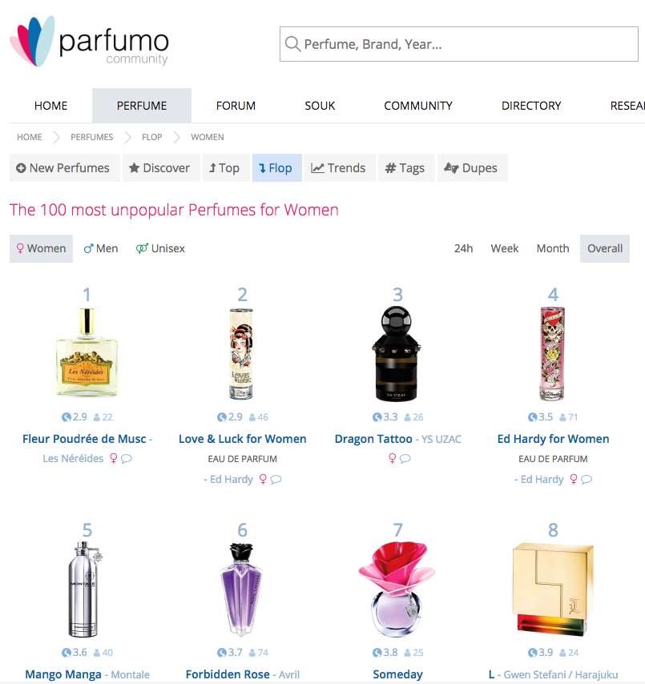
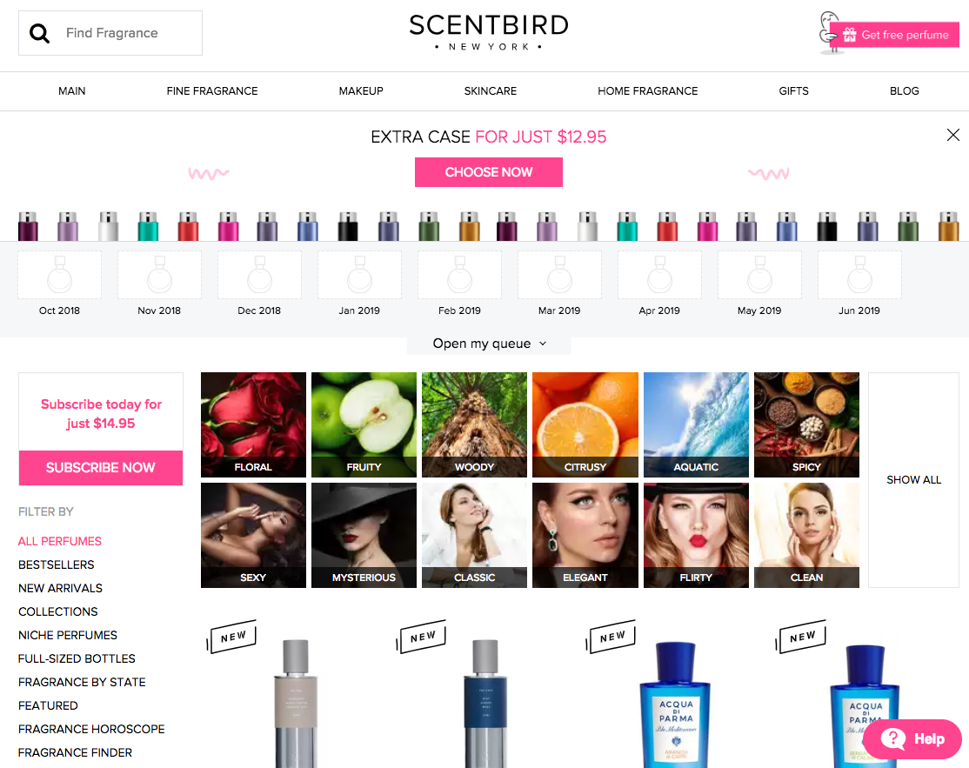
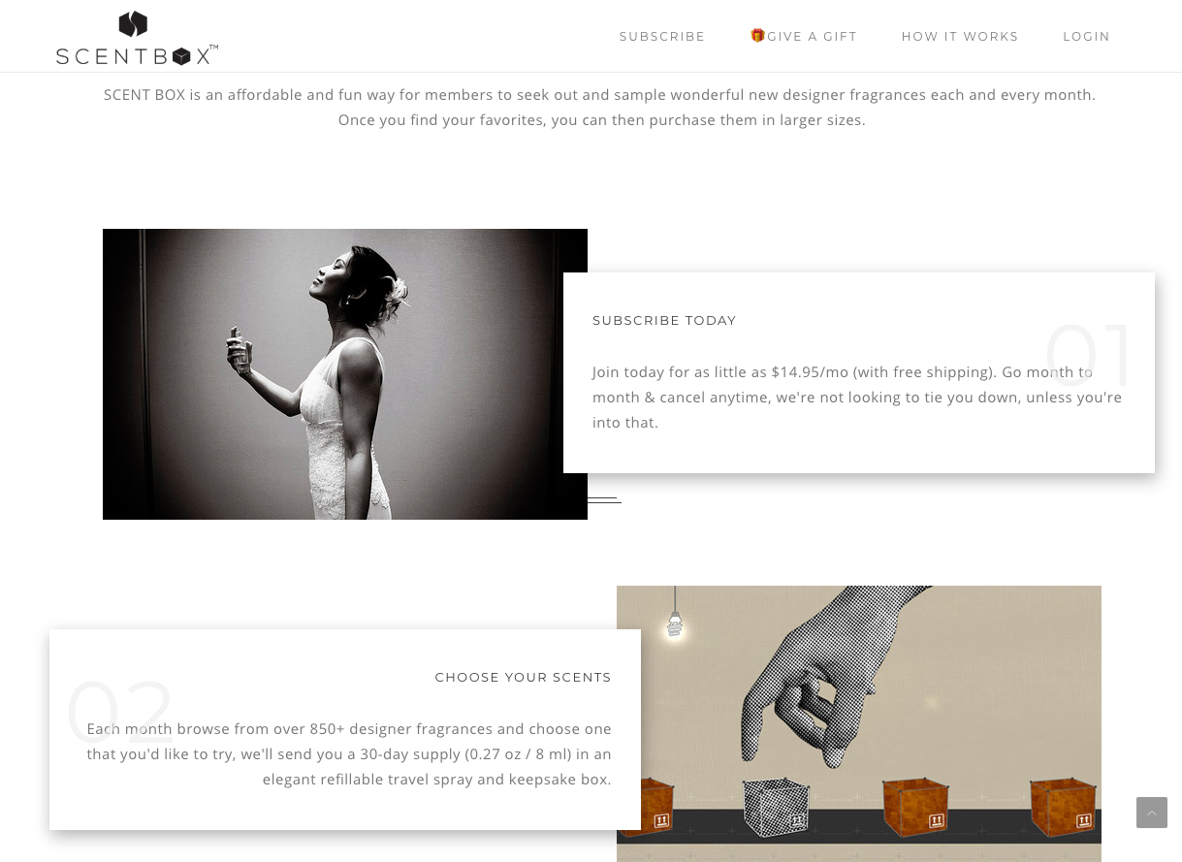
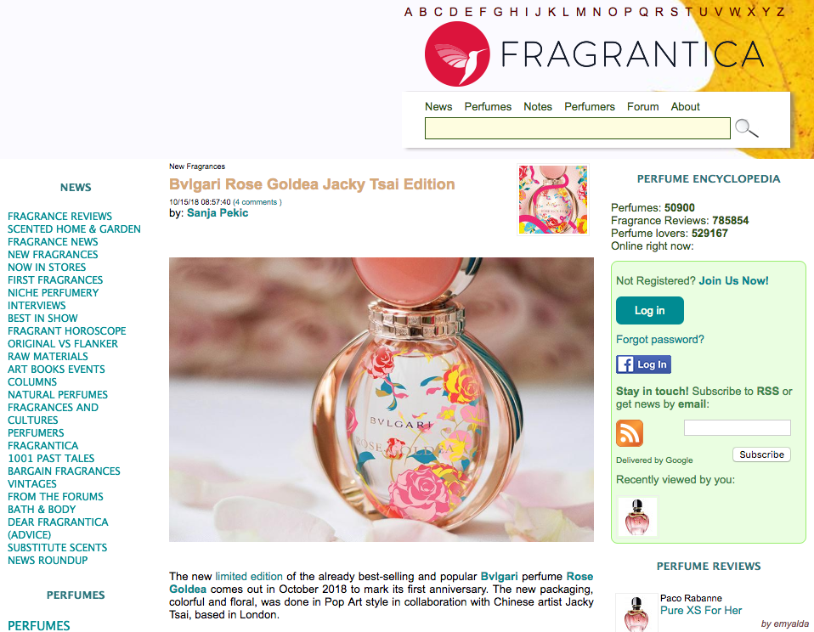

Slide 41
ScentSoul
EN
CN
Sing in About ScentSoul Contact me
ScentSoul
Your personal fragrance finder
Here are three ways to find your perfect match
TAKE A QUIZ
FIND SIMILAR
SIGN IN

Slide 42
ScentSoul
EN
CN
Sing in About ScentSoul Contact me
ScentSoul
Your personal fragrance finder
Here are three ways to find your perfect match
TAKE A QUIZ
FIND SIMILAR
SIGN IN

Slide 43
ScentSoul
EN
CN
Sing in About ScentSoul Contact me
Tell me something about you…

Slide 44


Slide 46
ScentSoul

